Slide 1
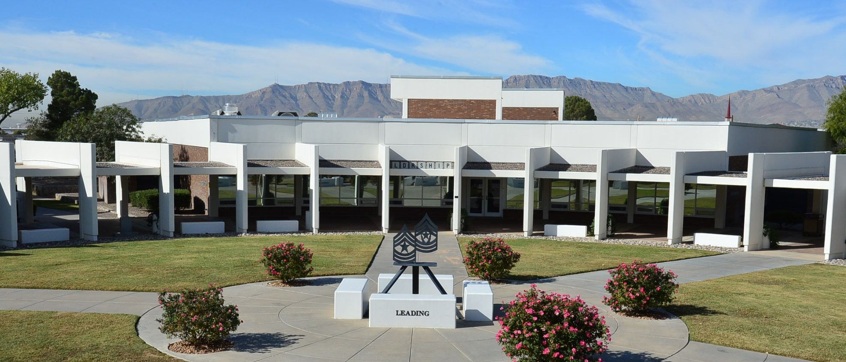
Questions?
L909 Protocol and Etiquette

Slide 2
This 1-hour lesson on protocol and etiquette is presented by a guest speaker. This lesson will cover Department of Army regulations concerning customs, courtesies, and traditions of the military. As a military spouse, you will attend many social and official occasions that are structured by long traditions. This lesson provides concise guidance and information for those special and challenging situations. As a result of this lesson, military spouses will have a better understanding of the Army’s customs, courtesies, and traditions.
Lesson Scope

Slide 3
Lesson ELO
ELO 400-SLDC-L909
Action: Define customs, courtesies, and traditions of the military.
Condition: As a spouse of a senior noncommissioned officer, a member of a problem-solving team, or individually in a classroom small group setting, using other references, class discussions, and personal experiences.
Standard: Understand customs, courtesies, and traditions of the military by-
Defining protocol, etiquette and traditions
Understanding the role of the Army spouse in formal and informal functions
Participating in question and answer session
Learning Domain: Cognitive
Level of Learning: Understanding
Lesson ELO

Slide 4
Protocol
The customs and courtesies dealing with diplomatic formalities, order of precedence, and etiquettes.
Etiquette
Conventional requirements pertaining to social behavior;
a prescribed or accepted code of conduct in matters of ceremony; implies observance of the formal requirements governing behavior in polite society.
Tradition
The handing down of statements, legends, customs, etc., from generation to generation by word of mouth; the practice of an unwritten body of law and doctrine.
Protocol * Etiquettes * Traditions

Slide 5
Listen
Call people by their name
Make eye contact
Shake hands with a firm grip
Say something nice
Smile and appear friendly
Stay relaxed
Sequence
The more honored/higher ranking person is stated first
Gender – woman to man
Age – older person to younger person
Position – senior rank to junior rank
“You never get a second chance to make a first impression.” Will Rogers
Introductions Meeting People

Slide 6
In Conversation (when speaking to the individual):
GEN, LTG, MG, BG = “General”
COL & LTC = “Colonel”
1LT & 2LT = “Lieutenant”
CWO & WO = “Mister, Miss or Mrs.”
CHAPLAINS = “Chaplain”
SMA, CSM & SGM = “Sergeants Major”
1SG = “First Sergeant”
MSG = “Master Sergeant”
SFC, SSG & SGT = “Sergeant”
Military Names, Ranks & Titles

Slide 7
Who to Invite to Spouses Welcome & Farewell
Battalion events, spouses of:
Brigade Command Team (Commander & CSM)
Other Battalion Command Teams within the brigade
Battalion officers
First Sergeants within the battalion
Division Command Team & General Officers (Optional)
Personal friends & Family of guest of honor
Brigade events, spouses of:
Division Command Team
Colonels & above in the division
Other Brigade Command Teams within the division
Brigade officers & sergeants major
Personal friends & Family of guest of honor
NOTE: Always have your guest list looked at by approving authority.
Invitations

Slide 8
Invitations
FORMAL and INFORMAL Invites:
Traditionally, invitations were handwritten and mailed.
With today’s technology, EVITE is the best way to go.
Send your invitation through EVITE of create a work document and send it via email.
When using EVITE or EMAIL, this allows you to better track RSVPs
NOTE: Always keep your email traffic/conversations in order to track any questions you might have about whether or not invitations were sent out, and it allows you to back track on RSVPs you might or might not have received.
Invitations (cont.)

Slide 9
The Commandant of
The Noncommissioned Officer Leadership Center of Excellence
requests the pleasure of your company
at a dinner in honor of
CSM Michael Grinston
Sergeant Major of the Army
on Friday, the seventeenth of August, at six o’clock in the evening
Centennial Banquet and Conference Center
Fort Bliss, TX
RSVP by: date Uniform: Duty
POC: norma.molina1.civ@mail.mil Civilian: Business Casual
(915) 744-8489
Invitations (cont.)

Slide 10
Invitations
Other things to think about when planning an event or sending out invitations, are:
“Save the date” – this should be done if you are planning an event that is more than 90 days out so that people can plan/mark their calendars.
Email both the Soldier and the Spouse
Blind Carbon Copy (BCC) all invitees; some people don’t like everyone to see their email address's
“Respondez S’il Vous Plait”
Civilians = “Please reply or “Reply requested”
Military – “Reply is mandatory”
Invitations (cont.)

Slide 11
Invitations should go out 4 weeks in advance.
Extend invitations to those who have extended one to you.
Avoid rank, title, etc. abbreviations -- Spell everything out!
An invitation to a married couple must be refused when either one or the other cannot accept:
True or False
Invitations Rules to Remember

Slide 12
CASUAL
(For Civilians)
Woman: Dress or Pant suit; this also depends on what the “Casual attire” is: i.e Texas Casual
Men: Shirt – open collar
Coat or Sweater
Dress Slacks
INFORMAL
Military
ASU w/four-in-hand tie or neck tab
Civilian
Men - Coat & Tie
Woman – Dress – Knee length
Proper Attire

Slide 13
Formal Attire
BLACK TIE WHITE TIE
MILITARY MILITARY
Dress Blue ASU Blue or White Mess
w/bow tie or neck tab
CIVILIAN
MEN – Tuxedo
WOMAN – Cocktail Dress or Evening Gown
NOTE: Generally, the later in the day/evening the event begins, the more formal the attire.
Formal Attire

Slide 14
Usually at the Battalion, Brigade & Division level
Held on regular basis (monthly, bi-monthly, quarterly)
Rotates location among the attendees wishing to host the event
Normally for spouses of senior NCOs & above
Morning event between 9:00 & 10:00; casual attire
Plain or fancy refreshments
Senior spouse may present a “standard” gift to the hostess for
the group
Provides a comfortable & relaxed forum to share information
& socialize
Introduce new arrivals, farewell departures & become acquainted
with other spouses
Provides mentorship to junior spouses
Socials Events Coffee

Slide 15
Usually at the Battalion, Brigade & Division level
Normally held in honor of someone arriving or departing
Most formal of daytime events
Normally for spouses of senior NCOs & Above
Afternoon event between 3:00 & 4:00; informal attire
Coffee, tea, punch, cookies, finger sandwiches are served
Expect to sign the guest book & go through the receiving line
Prepare to “stand & mingle” for the entire event
Requires china, silver service & linens
Senior spouse or guest of honor should serve coffee & tea (seated)
Next most senior spouse should serve punch (standing)
Pouring list may be used to rotate the duties
Socials Events Teas

Slide 16
ADJUTANT HOST GUEST of HONOR HOSTESS SPOUSE of Guest of Honor
NOTE: The Adjutant introduces guest and makes sure the line goes smoothly; does not shake hands or carries a conversation with Guests.
Do not generate small talk as you proceed through the line.
DO NOT LEAVE BEFORE GUEST OF HONOR.
Reception/Receiving Lines

Slide 17
Dining In
Formal event for Officers & NCOs
Spouses DO NOT Attend
Serves as a “function of unity”
Dining Out
Same as Dining In with spouses invited
An opportunity to join the “pomp & circumstance”
Balls
Same as Dining Out
Held to celebrate a special military occasion
Dining & Balls

Slide 18
Napkin--After being seated, unfold the napkin and place it across your knee; if away from the table during the meal, place it in your seat; after the meal, place it neatly to the left of your plate
Hostess should always lead the dining—wait until she begins then you may follow
Bread, rolls or toast--break with the hands, do not cut with a knife, never butter an entire slice of bread or toast
Eating Style: International (fork remains in left hand-knife remains in right) or American (fork switches from right > left > right when cutting/eating food) is equally acceptable.
Rules to Remember

Slide 19
?
?
?
?
QUIZ
?
?
?

Slide 20
A gentleman has just been introduced to a lady.
What should happen next?
The gentleman should extend his hand first to shake her hand.
The lady should extend her hand first to shake his hand.
Today, it doesn't matter who offers to shake
hands first.
Questions # 1

Slide 21
A gentleman has just been introduced to a lady.
What should happen next?
The gentleman should extend his hand first to shake her hand.
The lady should extend her hand first to shake his hand.
Today, it doesn't matter who offers to shake
hands first.
Questions # 1 Answer

Slide 22
You have extended written invitations that say R.S.V.P by May 10. What should you do about those guests who fail to respond by that date?
a. Give them a little longer.
b. Assume they are not coming.
Call and inquire if they received their invitation.
Question # 2

Slide 23
You have extended written invitations that say R.S.V.P by May 10. What should you do about those guests who fail to respond by that date?
a. Give them a little longer.
b. Assume they are not coming.
Call and inquire if they received their invitation.
Question # 2 Answer

Slide 24
You and your spouse have planned a party and
sent out invitations, when an invitation arrives for
another event from the division CSM on the same
evening. You should…
a. Quickly cancel, or postpone your party to
accept the CSM’s invitation.
Regret the CSM’s invitation, explaining that
you made prior plans.
Question # 3

Slide 25
You and your spouse have planned a party and
sent out invitations, when an invitation arrives for
another event from the division CSM on the same
evening. You should…
a. Quickly cancel, or postpone your party to
accept the CSM’s invitation.
Regret the CSM’s invitation, explaining that
you made prior plans.
c. Take your guests to the CSM’s party.
Question # 3 Answer

Slide 26
You and your spouse are invited to the CSM’s and his/her spouse’s home for dinner, afterward you should…
a. Write a thank-you note to the spouse.
b. Write a thank-you note to the CSM and his/her spouse.
Saying thank you as you leave is enough.
Question # 4

Slide 27
You and your spouse are invited to the CSM’s and his/her spouse’s home for dinner, afterward you should…
a. Write a thank-you note to the spouse.
b. Write a thank-you note to the CSM and his/her spouse.
Saying thank you as you leave is enough.
Question # 4 Answer

Slide 28
You live off post but close enough to hear “Retreat” in
the afternoons. You are outside playing with the children when the music starts playing. What should you do?
a. You and your children should stand at attention and face the music.
b. Run into the house quickly to avoid making any mistakes.
c. Stand at attention, remove your hat and place your hand over your heart.
Question # 5

Slide 29
You live off post but close enough to hear “Retreat” in
the afternoons. You are outside playing with the children when the music starts playing. What should you do?
a. You and your children should stand at attention and face the music.
b. Run into the house quickly to avoid making any mistakes.
c. Stand at attention, remove your hat and place your hand over your heart.
Question # 5 Answer

Slide 30
DA Pamphlet 600-60, A Guide to Protocol and
Etiquette for Official Entertainment
The Army Wife Handbook, Ann Crossley and
Carol A. Keller
Service Etiquette, Oretha D. Swartz
References

Slide 31
To our Military Spouses
Thank you for all you do in support of your Soldier
You are truly appreciated and are our Heroes behind the scene!
You are resilient
“Military Strong”
Mentors
Parents
And leaders in our Military Community!
Many Blessings to all of you!
NM – Protocol!
Thank you for what You do!!

Slide 32
Questions?
L909 Protocol and Etiquette

