Slide 1
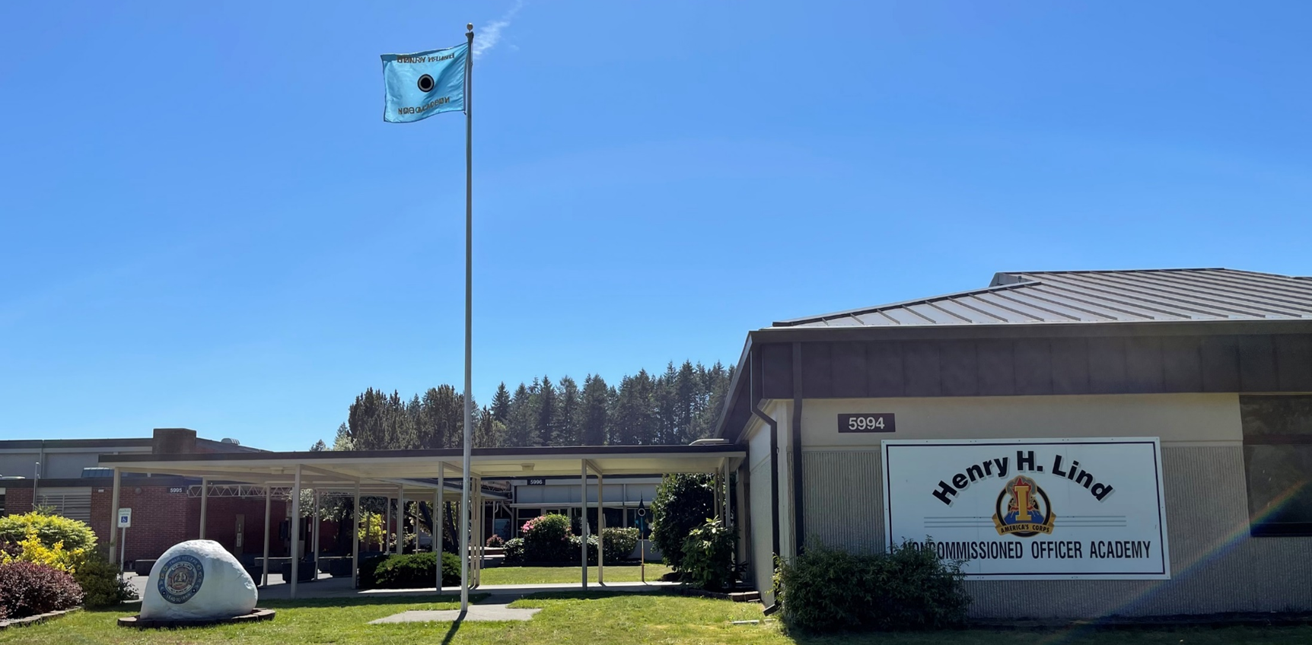
BLC CLASS
PRE-ENROLLMENT BRIEF
Our most up to date information and enrollment requirements can be found at:
JBLM NCOA Website: https://www.ncoworldwide.army.mil/Academics/NCO-Academies/Henry-H-Lind-NCO-Academy/

Slide 2
AGENDA
FILL DAY REPORTING
AFT & HT/WT
SOLDIER & SPONSOR INFORMATION
NCOA LAYOUT
GPA PRODUCING EVENTS
EXAMPLE SCHEDULE
HOW TO REACH US
QUESTIONS

Slide 3
FILL DAY REPORTING
Roll Call- Fill Day @ 0600
Line for all reservations will form at the North End of NCOA Auditorium
Line for walk-on will form at the South End of NCOA HQ (BLDG 5996)
All ATRRS (R), ATRRS (W), and Walk-Ons MUST be present for formation
Have all profiles in hand during formation
Uniform- ACU w/ patrol cap
Profile (must be on hand during entirety of Fill Day)
Uniform MUST be serviceable and grooming standards MUST be IAW AR 670-1. Uniform inspections will be conducted daily.
Requirements-
OML: SGTs, SPC(P), SPC, PFC
Soldiers no longer need to be in a promotable status to attend BLC

Slide 4
AFT/Height and Weight
Will Conduct the AFT - Training Day 1
All students will be instructed on proper form and performance for all 5 events prior to release on Day 0.
Failures will retest no earlier than 7 days later
Soldiers will be graded within the guidance IAW Army Directive 2025-06
AFT Combat standard is sex-neutral and age normed.
AFT combat standard applies to Soldiers serving in these AOCs and MOSs: 11A, 11B, 11C, 11Z, 12A, 12B, 13A, 13F, 18A, 180A, 18B, 18C, 18D, 18E, 18F, 18Z, 19A, 19C, 19D, 19K, and 19Z.
Will Conduct Height/Weight Screening – Training Day 2
Body Fat Assessment will be conducted IAW Army Regulation 600-9
First time Body Fat Assessment failure will result in removal from Honors
Failures will retest no earlier than 7 days later / Second time failures will be dismissed from the course. If you pass H&W re-screening, you will remain in the course
First time failures will be afforded an opportunity for a supplemental test at the Army Wellness Center prior to dismissal.
ABCP Exemptions IAW Army Directive 2025-17, an AFT that has a minimum score of 465 with minimum 80 points in each event.

Slide 5
SOLDIER & SPONSOR INFORMATION
There will be no training on Saturday’s
You will be expected to wear Business Casual Attire once (I Corps Blue Book for Standard)
You will graduate in ASU/AGSU Class A or B variant
Exceptions must be approved by the BLC Branch Chief
Missed Time
No appointments or training will be scheduled during the course. Any missed class must be approved by the BLC Branch Chief.
While attending BLC, The NCOA is your primary place of duty
Units will NOT use Students for tasking or duty during this course
Unexcused absences will result in counseling and removal from Honors and possibly dismissal

Slide 6
SOLDIER & SPONSOR INFORMATION
Bring ALL profiles to Day 0 (P2, P3, etc.)
Permanent Profiles
If you are on a permanent profile (P2), you will conduct the AFT IAW your profile limitations
If you are on a permanent profile (P3), profile must include a copy of your MOS Administrative Retention Review Board results
Shaving Profiles, will have to also have ETP signed by O-5 IAW new Army Directive
Must be updated with what AFT events CAN/CANNOT be taken
Temporary Profiles- Are Permitted in the Course (if they meet the follow requirements)
Must meet all physical requirement of the course, to include any physical fitness graduation requirements.
They cannot have any recurring physical or operational therapies where the Soldier would miss training.
The Soldier's PCM must concur on the profile with the Soldier's ability to meet the physical requirements of the course.
If you do not meet the requirements above submit the profile to I Corps Schools manager for removal from the course.

Slide 7
SOLDIER & SPONSOR INFORMATION
Postpartum
Let your SGL know on Fill Day
You are exempt from height and weight 365 days after the pregnancy ends
You are required to take an AFT
Must provide “Volunteering to Attend Basic Leader Course (BLC) While in a Postpartum Status” Memo. Please send that memo to Training Support Branch NCOIC prior to Fill Day. Failure to provide memo at 0600 on fill day will result in a denied enrollment.
The Academy WILL accommodate breast feeding/pumping– Let your SGL know on Fill Day
Packing List
Layout/Inspection will be on Fill Day
Army issued gear only!!
If you do not have what is on the packing list due to JRTC, NTC, PCS etc., Your Company CDR signs a memo requesting a temporary second issue from CIF. CIF will issue you the required items for BLC. You will return the items to CIF when you graduate. If CIF does not have something in stock, get paperwork from CIF and provide that during the layout

Slide 8
SOLDIER & SPONSOR INFORMATION
Failure to have computer and A365 access on Training Day 3, will result in being released from the course.
Failure to have a completed enrollment packet by 0900 on Training Day 3, will result in being released from the course.
Failure to have all items on the packing list by 0900 on Training Day 3, will result in being released from the course.
Students will be required to communicate any deficiencies to their sponsors. Sponsors are responsible for ensuring their student has all required documentation and gear. Students WILL NOT be allowed to miss any class to correct deficiencies.

Slide 9
GRADUATION REQUIREMENTS
GPA PRODUCING EVENTS
PRT
Drill & Ceremonies
Informative Essay
Compare and Contrast Essay
Public Speaking
Conduct Individual Training
NON-GPA REQUIREMENTS
PASS THE AFT
MEET HEIGHT AND WEIGHT REQUIREMENTS

Slide 10
EXAMPLE SCHEDULE

Slide 11
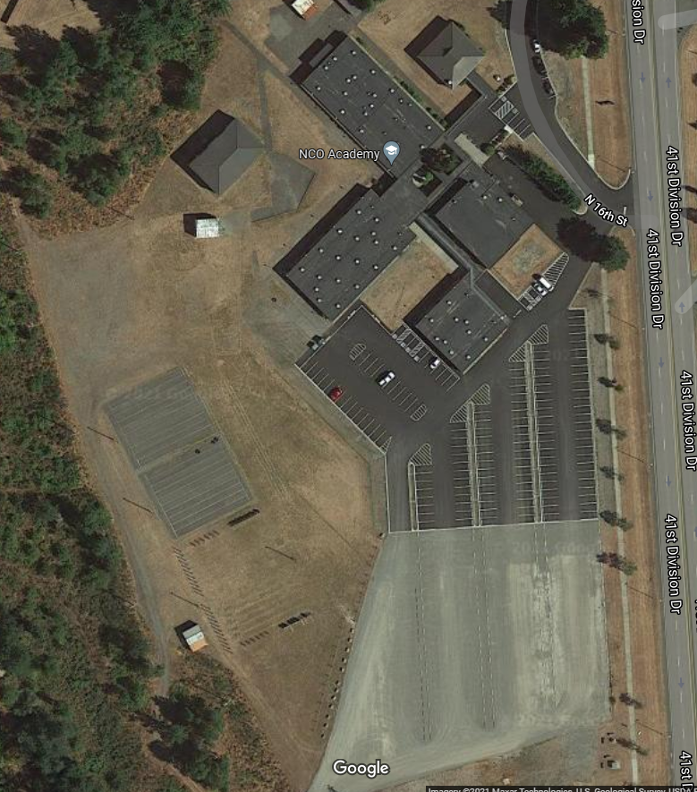
NCOA LAYOUT
Key:
Student Entrance
Parking
Classrooms
Auditorium (Day 0 Formation)
Daily Formation Area
BLC Branch Chief & SSGLs

Slide 12
HOW TO REACH US
Please work through your CO/BN/BDE Schools Reps(s) regarding enrollment before contacting the NCOA
MSG Jonathan Lainez - BLC Branch Chief
Jonathan.H.Lainez.mil@army.mil
253-967-6527
Training Support Branch
253-967-4911
JBLM NCOA Website: https://www.ncoworldwide.army.mil/Academics/NCO-Academies/Henry-H-Lind-NCO-Academy/
JBLM NCOA Facebook page: https://www.facebook.com/JBLMNCOA/
Watch our Facebook for updates.

Slide 13
QUESTIONS
?????

