Slide 1
MODERN
VOLUNTEER MANAGEMENT
INFORMATION SYSTEM
(VMIS)
FOR VOLUNTEERS

Slide 2
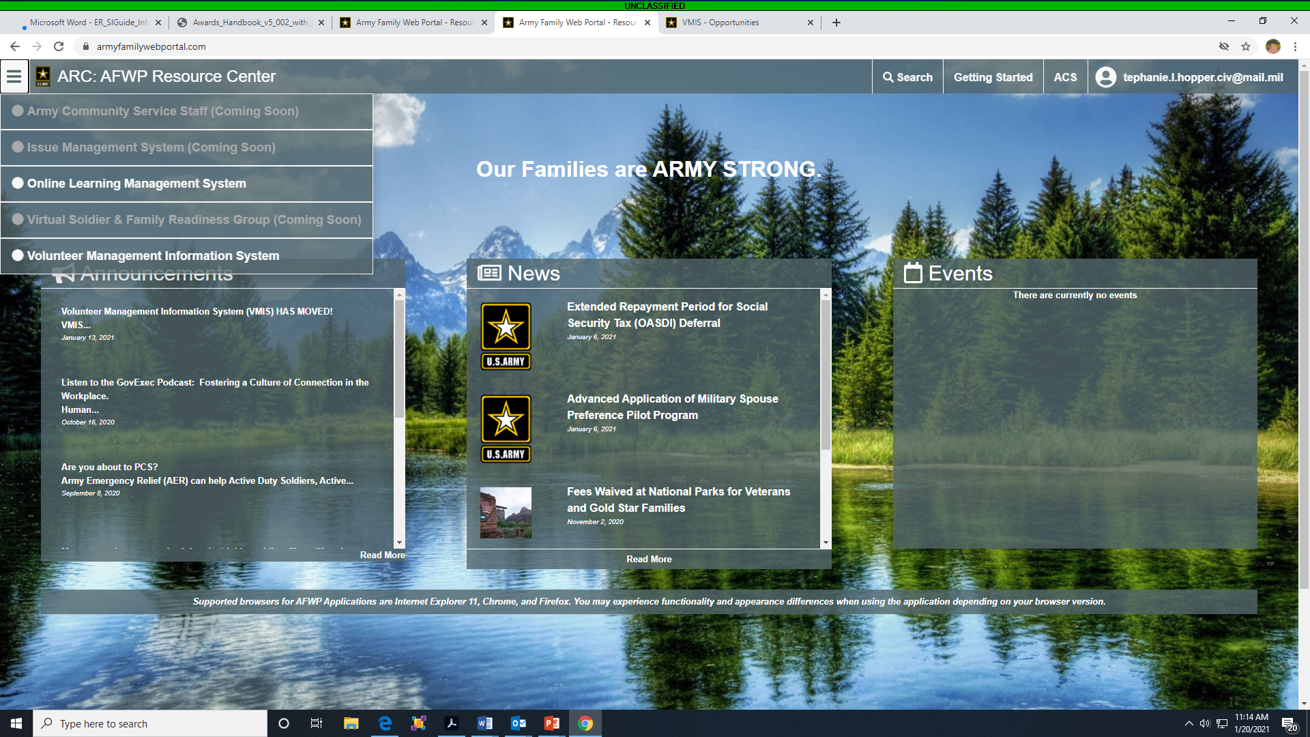
Go to: armyfamilywebportal.com
Click on the menu in the top left corner and select Volunteer Management Information System (VMIS)
Or to go directly to the VMIS Log-in at: vmis.armyfamilywebportal.com

Slide 3
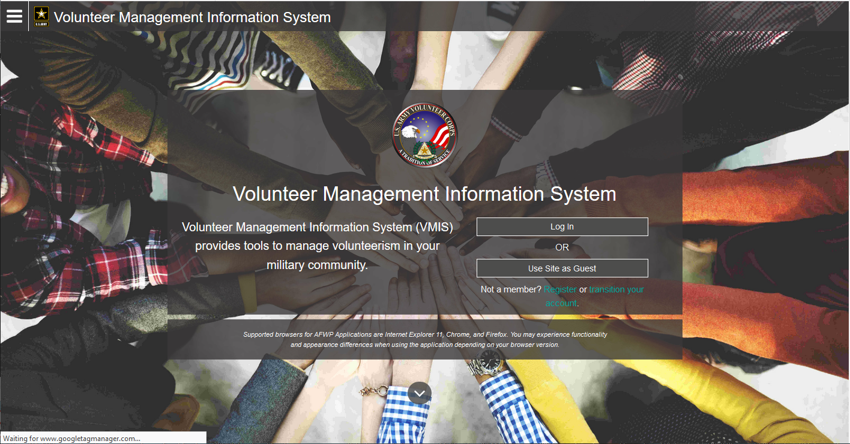
NEW VOLUNTEERS: Register an account
EXISTING VOLUNTEERS: If you had a legacy VMIS account,
transition your account to the new system
If you already transitioned your account – Log In

Slide 4
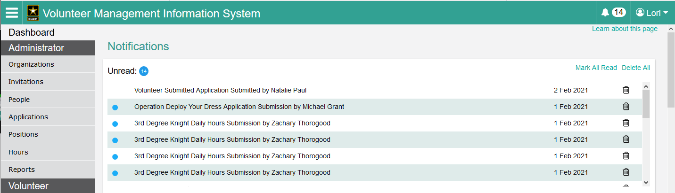
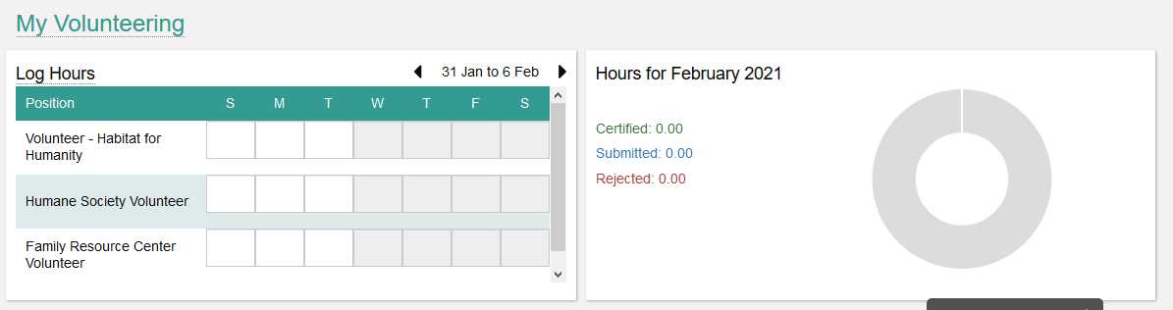
VOLUNTEER DASHBOARD
The Volunteer Dashboard provides resources that volunteers can use daily and include Notifications, My Volunteering and a hour chart representing the volunteer’s current number of submitted, approved and rejected hours for the month. The Volunteer Dashboard can be accessed from any page on VMIS while logged in as a volunteer – simply select ‘Dashboard’ from the left-hand navigation menu.

Slide 5
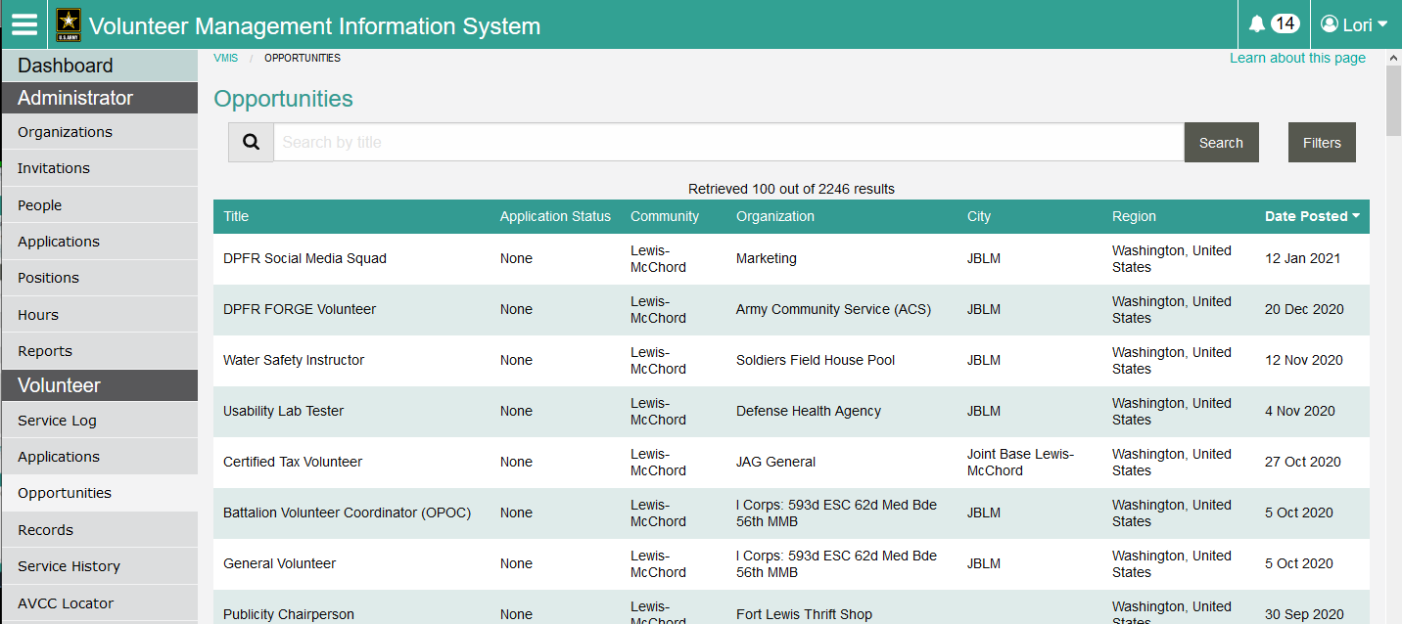
SEARCH FOR OPPORTUNITIES
The Opportunities page allows you to search for and apply to many different volunteer opportunities. You can sort and filter opportunities, and you can browse opportunities without creating a VMIS account.
Click on the position title to view specific information and apply

Slide 6
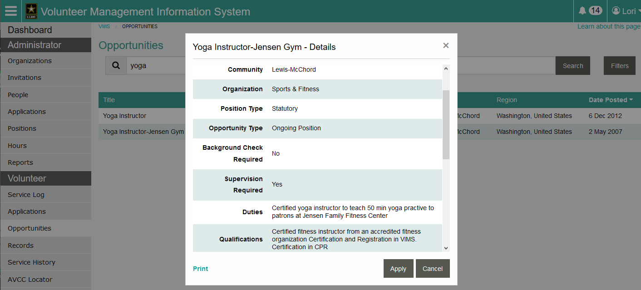
APPLY FOR VOLUNTEER POSITION(S)

Slide 7
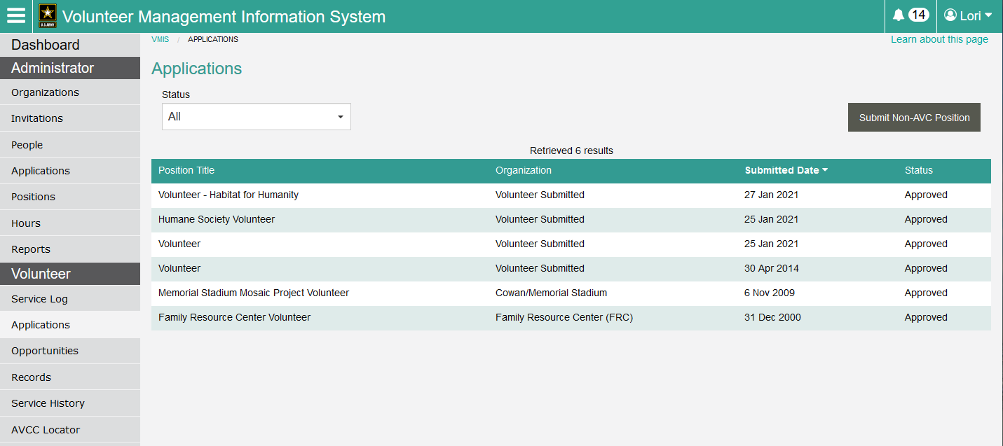
APPLICATIONS
View the status of your applications.
Do you volunteer off-base? Submit a Non-AVC position. The AVC (Volunteer Office) will accept the Non-AVC position and you will be able to record hours. Submitted hours will NOT be certified until you provide verification from the organization to the AVC.
**Include the organization name in the position title i.e., Habitat for Humanity Volunteer

Slide 8
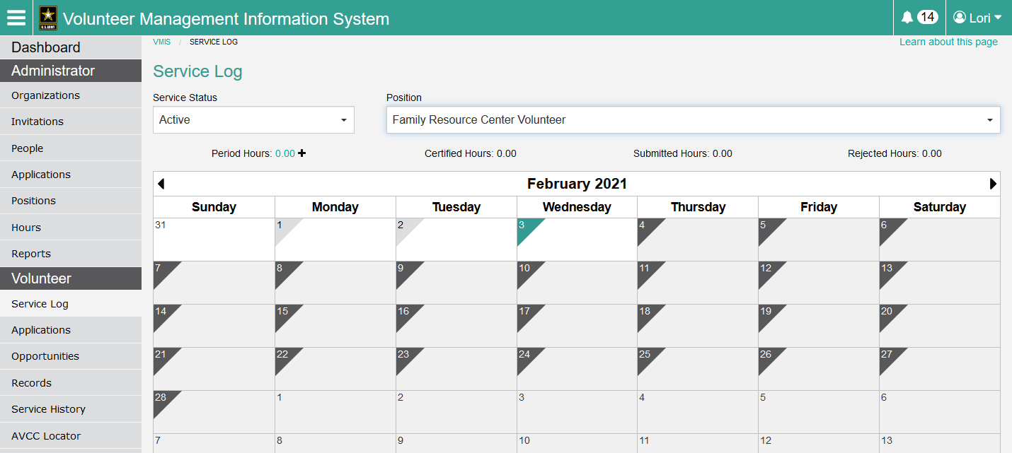
GO TO THE SERVICE LOG TO RECORD VOLUNTER HOURS
Hours may be recorded within the current fiscal year.
Record daily hours by clicking the date and entering your hours.
If you miss the deadline for current hours, click the arrow for the previous month(s) and then click the (+) next to Period Hours to record past hours.

Slide 9
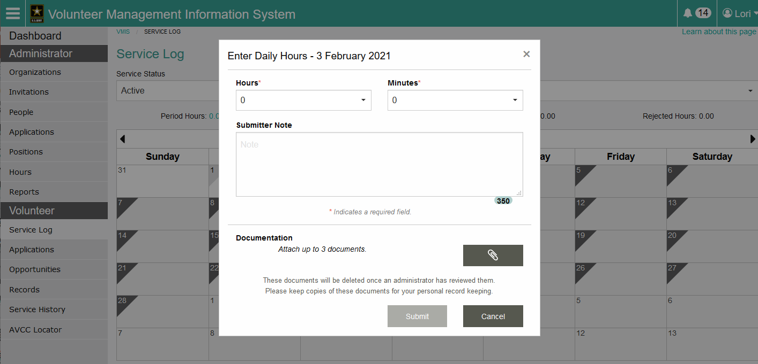
RECORD DAILY VOLUNTEER HOURS

Slide 10
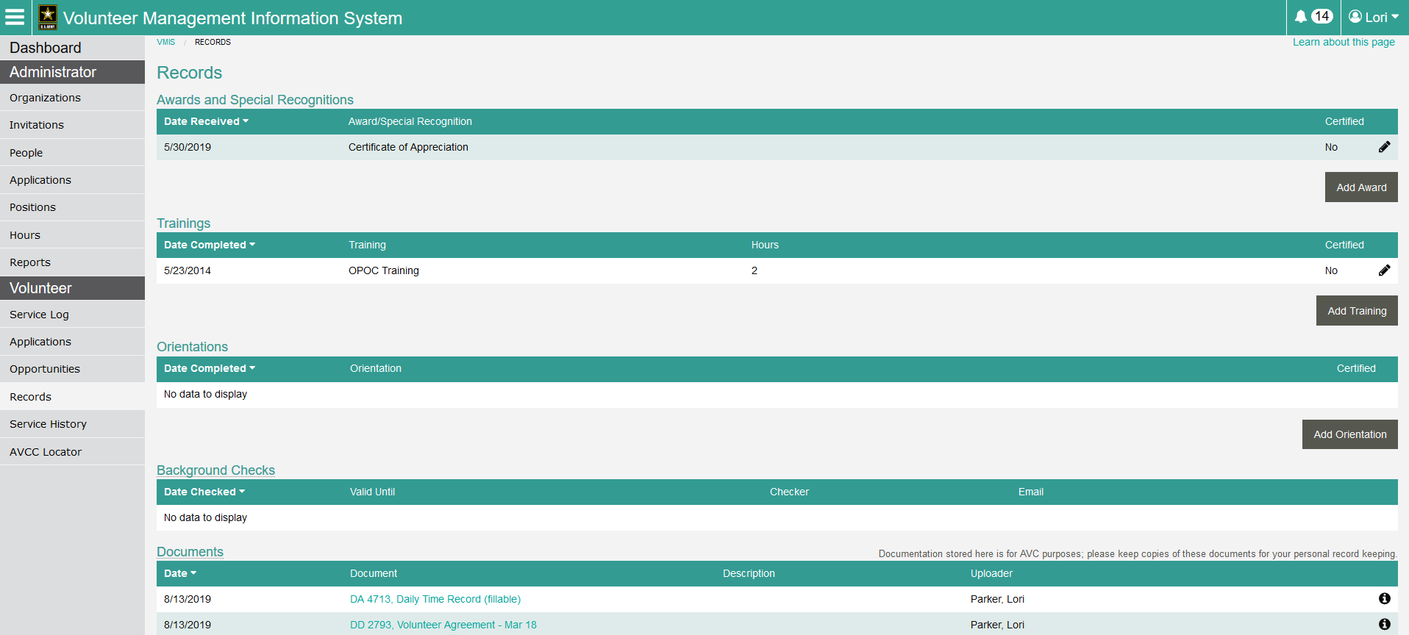
ENTER RECORDS
The Records page allows a user to document any awards received, trainings or orientations they have completed, as well as the certification status for any of these items.
Documents may be uploaded by your OPOC or AVC, however items stored are for AVC purposes. Please keep copies of all of your documents for your personal record keeping.

Slide 11
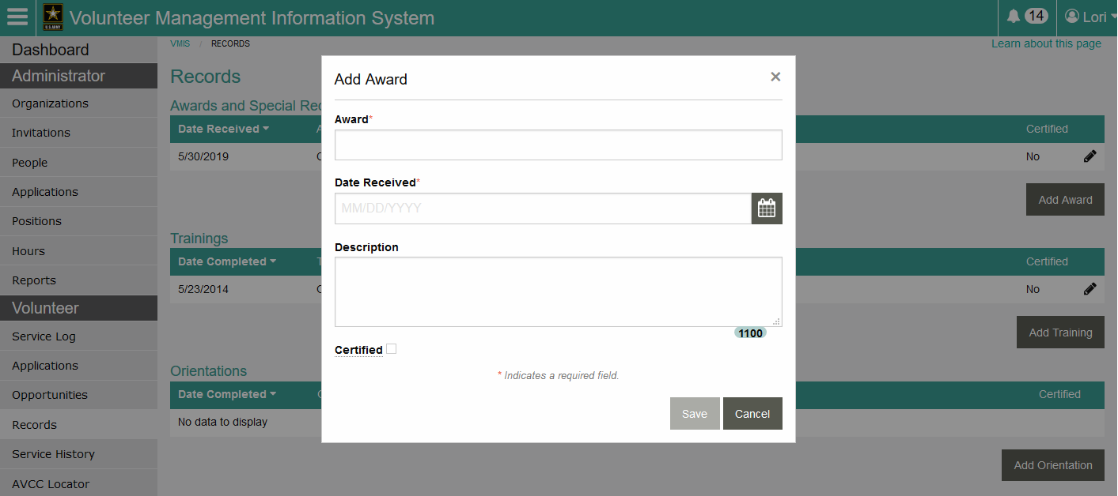
ADD AWARD/TRAINING/ORIENTATION

Slide 12
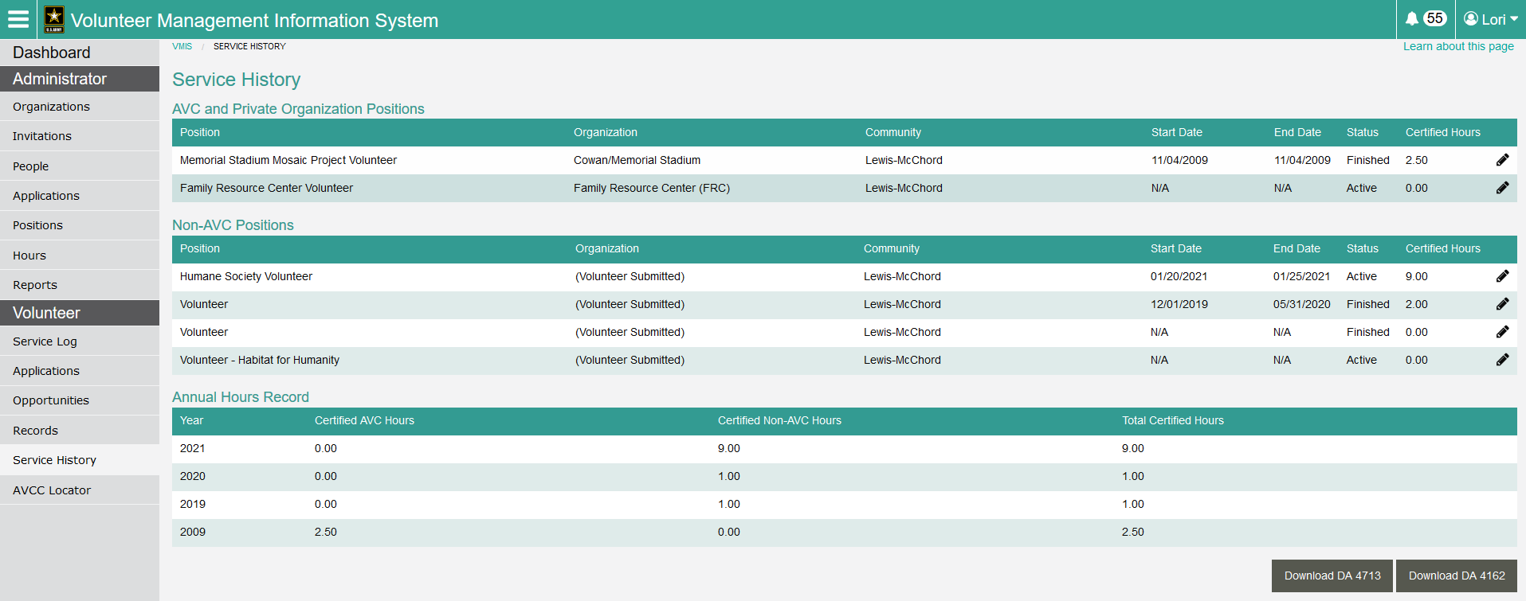
SERVICE HISTORY
The Service History page provides a summary of your volunteer hours broken down by position (AVC/Non-AVC) and a total number of annual certified hours.
You can also download copies of the DA 4713 (Daily Time Record) and DA 4162 (Service History Record) from this page.

Slide 13
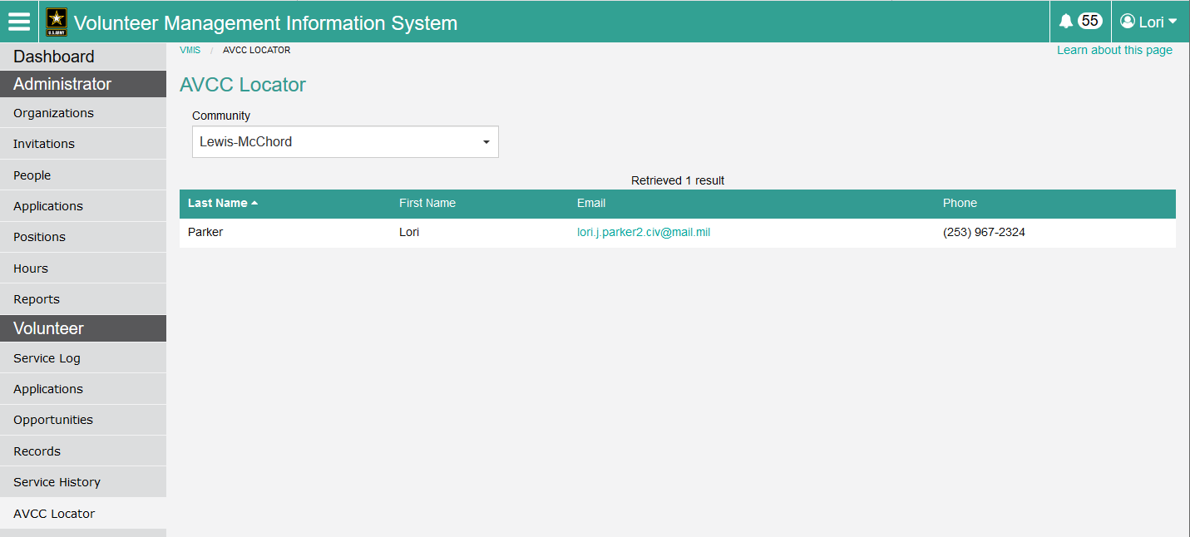
AVCC LOCATOR

Slide 14
QUESTIONS
Call AVC Program Manager at 915-569-7733
E-mail: tephanie.l.hopper.civ@mail.mil

