Slide 1
Testimonials
For More Information
“The Spouse Leadership Development Course (SLDC) is a wise and accessible way to invest in yourself as a senior military spouse. This was one of the most wonderful and welcome “surprises” the military has given me in the last 1.5 decades of loving my service member. SLDC was a delightful balance of insight and information with an undercurrent of authenticity. The time allotted for the course material was highly efficient (no “hurry up and wait” here!) Unexpectedly, the course left me with renewed energy and excitement for the next chapter of military spouse life, be it two years or ten. I’m recharged and ready to go the distance with my (future) Sergeant Major Service Member!” Sharita, Army Spouse 2024
Ms. Michelle Mebane
Chief, SLDC michelle.m.mebane.civ@army.mil (915) 744-1201, DSN: 621
Mailing Address
The NCO Leadership Center of Excellence & Sergeants Major Academy
11291 SGT E. Churchill Street Fort Bliss, Texas 79918-8002
Phone: (915) 744-8009 (DSN: 621)
Fax: (915) 744-8484
“Being a Marine Corps Spouse, I approached the SLDC course with a sense of uncertainty. I had no idea what to expect. The training was incredibly diverse, and I left with a vast amount of knowledge that far surpassed my initial expectations. I owe this to every individual who generously shared their expertise and resources. Their contributions made this course genuinely enjoyable. I also had the pleasure of meeting and connecting with some extraordinary senior spouses who will leave an indelible mark on my memories of Fort Bliss. I wholeheartedly encourage everyone, regardless of their branch of service, to partake in this incredible experience. I guarantee it will leave you impressed and fulfilled!” Linda, Marine Corps Spouse 2024
SLDC
Connect With Us
https://www.ncolcoe.army.mil/
https://www.ncoworldwide.army.mil/
https://www.facebook.com/NCOLCoE
https://www.twitter.com/NCOLCoE
Spouse Leadership Development Course
https://www.youtube.com/TheNCOLCoE
“You are not alone. #1 lesson learned from attending SLDC. I recommend this course to any senior spouse. From understanding your resources, connecting with our community to just having a moment to focus on your own development, this is the place to do it. With options ranging from in person to online and a flexible schedule designed to meet you where you are in terms of time, this course has eradicated any excuses. In addition to the course’s availability - the content, positive energy and connect-ability was unexpected and personally rewarding.” Nicole, National Guard Spouse 2024
“The SLDC is an excellent opportunity for senior military spouses who want to improve their leadership skills and personal growth. This course offers valuable resources and tools that can help enhance leadership effectiveness and build a supportive network among participants. Military spouses may encounter unique challenges, and the SLDC provides a welcoming space for connection and support, addressing potential isolation experienced within this lifestyle.” Fernanda, Veteran, Army Spouse 2024
“I recommend SLDC to anyone who has the opportunity to attend. As an international spouse, I wanted to attend the course primarily to meet and get to know people in the same situation as me. I discovered early on that this course is more than a social event. You will be met by talented lecturers with a lot of expertise in their field. We share our experiences across borders and learn so much from each other. I also got an insight into what everyday life in the Armed Forces here in the United States is like, what rights one has and how one can support and help each other. After the course, I am left with an appreciation for having the opportunity to attend the course.” Anette, International Spouse 2024
https://www.instagram.com/ncolcoepao/
https://www.linkedin.com/school/ncol-coe/
“Resource, Not Rescue”

Slide 2
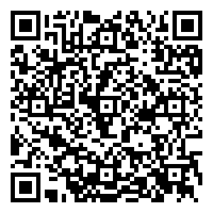
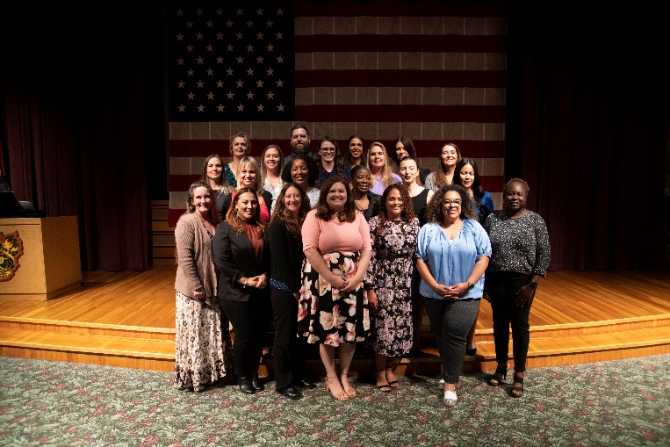
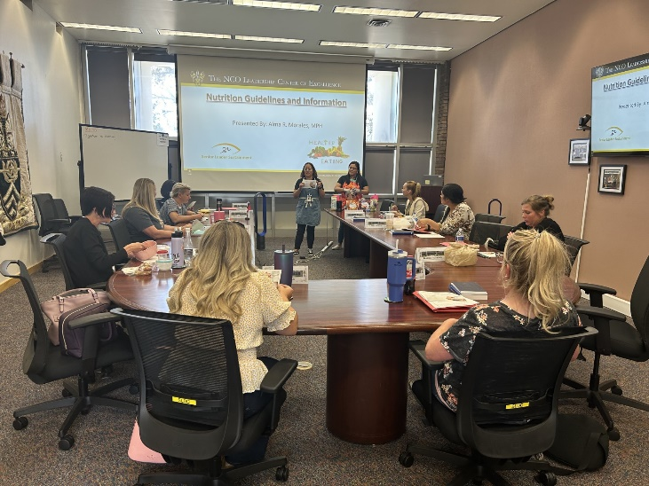
Our Mission
Course Map
Course Scope
Educate senior enlisted spouses from the U.S. Army, sister services, and allied militaries to promote a team-building approach by enhancing and developing leadership skills to support readiness, morale, and a successful command.
Welcome/Opening Remarks
SLDC Orientation
Team Building: Group Dynamics
Self-Awareness (16 Personalities Test) Public Speaking and Presentations
The Senior Spouse Role in the Soldier & Family Readiness Group & Deployment Discussion
Leadership & the Senior Spouse
Army Overview (NCO Heritage & Education Center (Virtual Tour)
Protocol and Etiquette
The Senior Spouse Overview of Army Family Programs
Senior Spouse Role in Recruiting & Thanking Volunteers
Volunteer Management Information System (VMIS)
Public Affairs/Media/Security & Social Media
Benefits and Entitlements: Preparing for
Retirement
Ethics
Care Team Training
Marriage and the Senior Spouse Resilience
American Red Cross
Problem Solving & Decision Making Dress for Success
Suicide Prevention Healthy Eating
The Spouse Leadership Development Course is a 40- hour resident Army Training Requirements Resources System leadership support course designed for senior enlisted spouses from the U.S. Army, sister services, and allied militaries. It prepares them for leadership support positions in the military community. Major subject areas include programs in human psychology, human relations training, and leadership development. Spouses also learn healthy conflict management resolution techniques, protocol, public speaking and communication, effective listening, and team-building skills. Soldier & Family readiness group training is also
part of the curriculum, and spouses also receive in-depth information about benefits and entitlements. The Spouse Leadership Development Course combines lecture, discussion, and small group experiential learning methodologies.
Course Goals
Builds upon the senior spouse’s basic knowledge of leadership, group dynamics, and team-building by enhancing awareness of current theories, and models of human
psychology.
Encourages, and supports expression of diverse ideas, opinions, and beliefs related to current issues, and challenges facing Families regarding Army living, programs, and transformation initiatives.
Forges, and maintains strong peer support groups among senior spouses, and creates a support network to sustain progress beyond the course.
Sleep Connection
Sexual Harassment Assault Response Prevention (SHARP)
Planning a Reception
After Action Review
Senior Spouse Panel
Guest Speakers
Graduation
Examinations are not conducted in this course!
QR Code (Schedule/Information)
Registration
Chief: Ms. Michelle Mebane Email: michelle.m.mebane.civ@army.mil
Work: 915-744-1201
Modes of Delivery
Face to Face
Virtual
Distributed Learning
“The professional face of modern military
spouses has changed significantly.”

